Slide 1
Cyclops– Vocabulary and Dataset Creation
Joanne Yoon, Anurag Bejju, Alex El-Hajj, Denise Chen, Saeid Molladavoudi, Nick Denis, Monica Pickard
February 03, 2020

Slide 2
Annotation Datasets

Slide 3
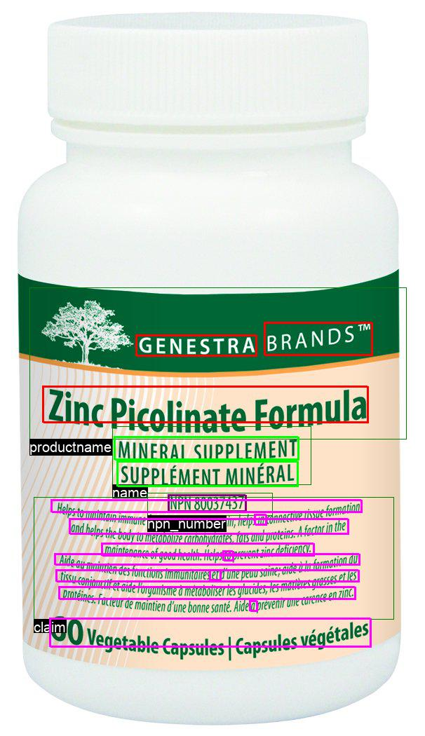
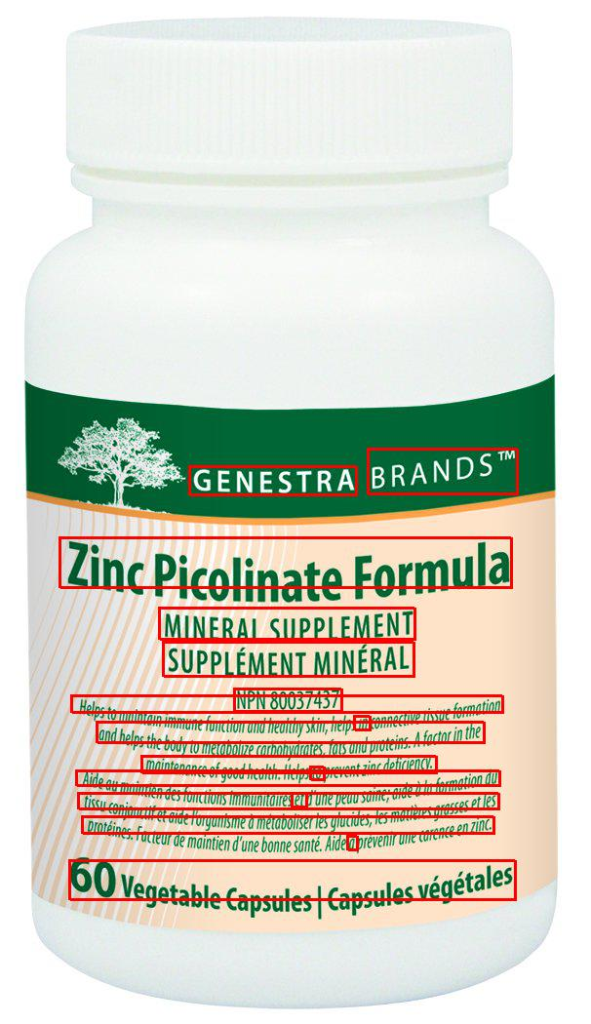
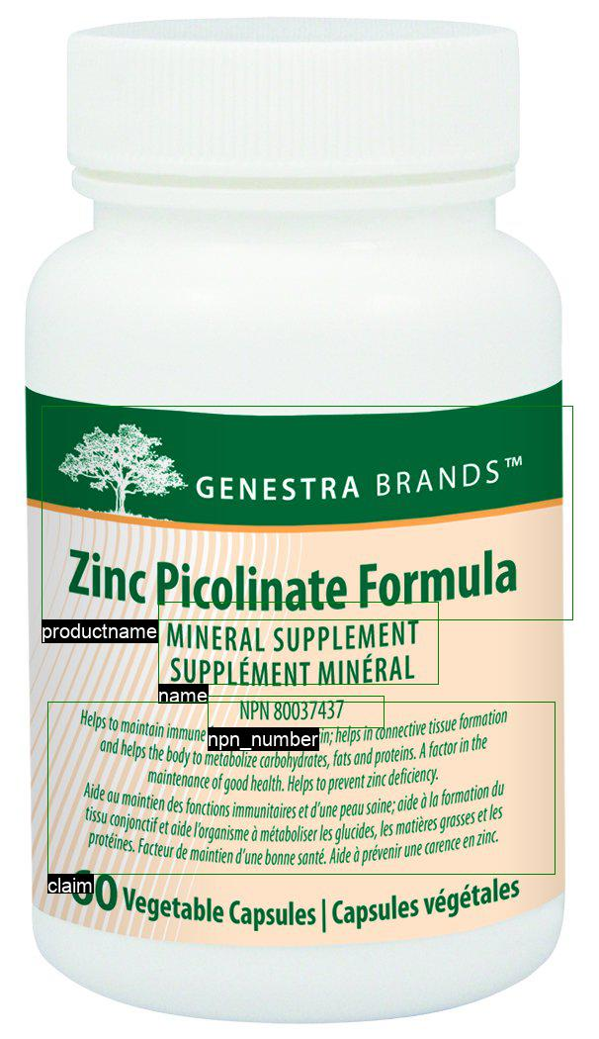
Creating Datasets using OCR data and annotations
+
=
OCR Tokens
Annotation Output
OCR + Annotation

Slide 4
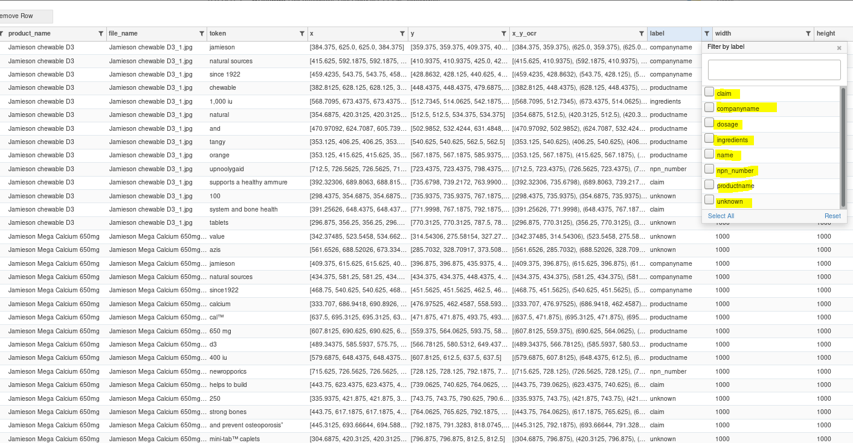
Final Output

Slide 5
NPN Extraction via OCR

Slide 6
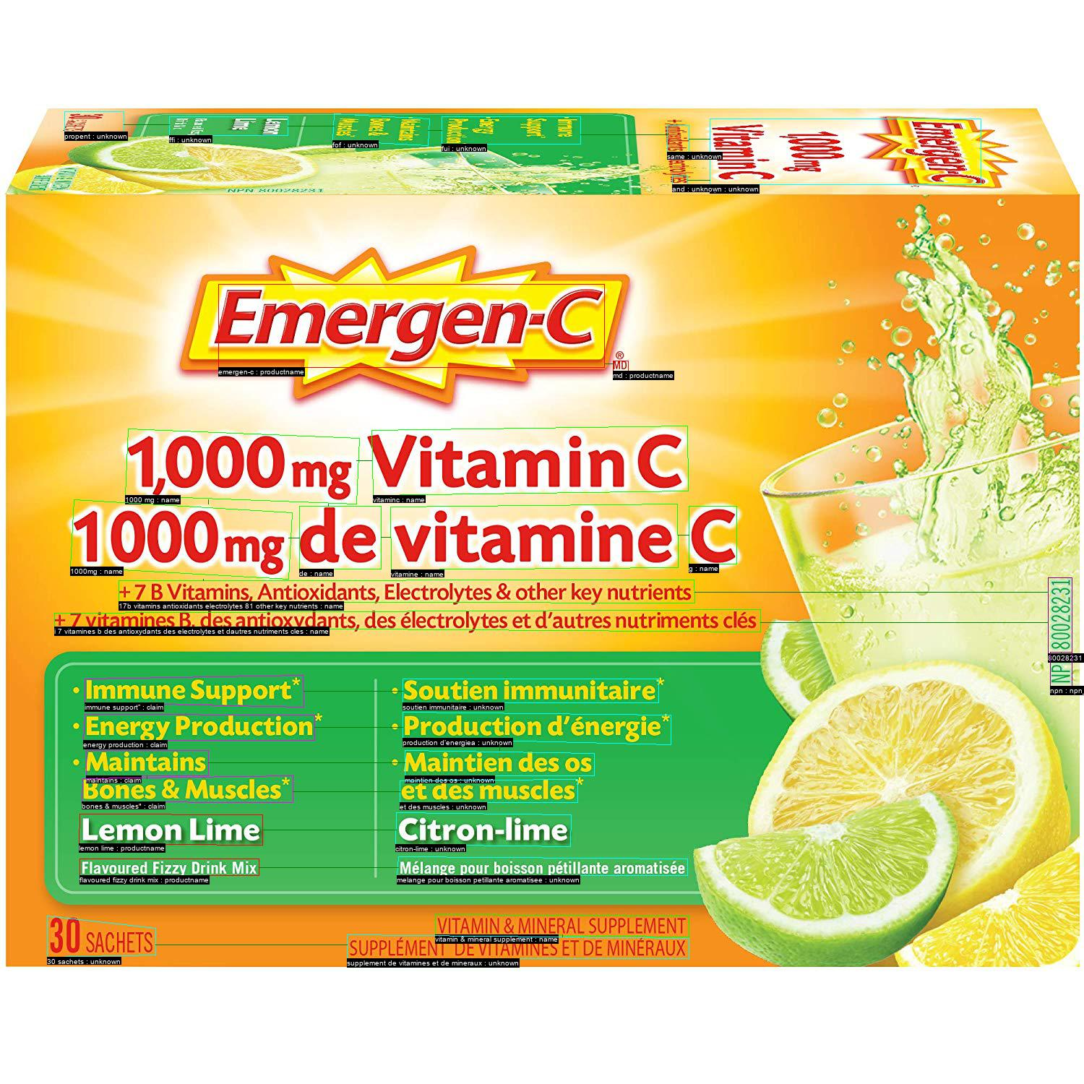
Revisiting OCR performance on NPNs

Slide 7
Modifying OCR to read NPNs better
Most of the time NPNs are:
Rotated
Small font
Low quality…
May take the NPN+Number as one word
Over messy background
Need to depend on DTR over tesseract

Slide 8
OCR + SymSpell Analysis

Slide 9
OCR + SymSpell Analysis
896 Products

Slide 10
OCR + SymSpell Analysis
896 Products
79.1%
OCR perfectly extracted words

Slide 11
OCR + SymSpell Analysis
896 Products
79.1%
334 or 37.3%
OCR perfectly extracted words
OCR perfectly extracted NPNs

Slide 12
OCR + SymSpell Analysis
1 Edit Distance
2 Edit Distance
SymSpell w/ a single exact match:
82.6% of OCR words get matched to vocabulary
An additional 18 NPNs get matched exactly (39.3% of products)
SymSpell w/ multiple matches:
7942 (6.7%) of words have multiple matches
An additional 87 NPNs are extracted, though they match to multiple different NPN (see Figure)
47% of products have extracted NPN
10.2% (12,085 words) have no matches after OCR/SymSpell
SymSpelll w/ a single exact match:
, 84.0% of OCR words get matched to vocabulary
An additional 39 NPNs get matched exactly (41.6% of products)
SymSpell w/ multiple matches:
11, 758(9.9%) of words have multiple matches
An additional 125 NPNs are extracted, though they match to multiple different NPN (see Figure)
55.6% of products have extracted NPN
5.6% (6,606 words) have no matches after OCR/SymSpell

Slide 13
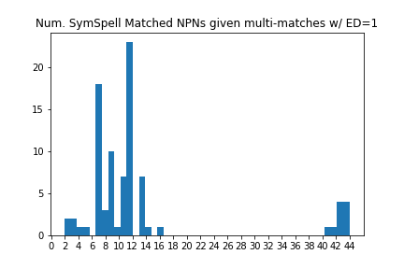
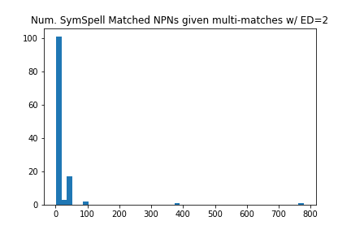
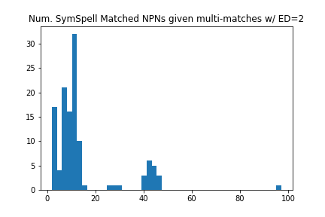
NPNs with Multiple Matches

Slide 14
Initial Word Classifier Results
Baseline: NHP Dataset

Slide 15
99.63% Test Accuracy
Prediction
 | Company address | Risk | Med. Ingred. | Dose | Claims | Comp. name | Non-med Ingred. | Product name | NPN
Company address | 696 | 0 | 61 | 0 | 1 | 3 | 4 | 163 | 6
Risk | 1 | 805226 | 35 | 0 | 557 | 3 | 0 | 18 | 0
Medicinal Ingredients | 31 | 1 | 7451 | 4 | 12 | 4 | 632 | 965 | 3
Dose | 0 | 0 | 29 | 12 | 0 | 0 | 0 | 8 | 0
Claims | 1 | 239 | 16 | 0 | 432498 | 1 | 1 | 104 | 0
Company name | 7 | 0 | 5 | 0 | 0 | 995 | 2 | 202 | 0
Non-med Ingredients | 1 | 0 | 579 | 0 | 15 | 2 | 1387 | 377 | 0
Product name | 43 | 2 | 455 | 0 | 109 | 78 | 209 | 57347 | 0
NPN | 1 | 0 | 0 | 0 | 0 | 0 | 0 | 0 | 22862
True Class

Slide 16
Test: Concatenated Inputs Dataset
N = 5 concatenated inputs:
82.2% accuracy
N=10
76.6% accuracy
N=20
73.3% accuracy
N=40
71.4% accuracy

Slide 17
FrontEnd Pages (Search Products)
NPN Confirmation
Product Name & Company name
Confirmation
Products Identified
Output for each page
Licensed_product.json
Licensed number (NPN)
Lnhpd_ID
Top 10 Hits
If none Correct:
User Input Box

Slide 18

FrontEnd Pages (Matched medicinal Ingredients)
User Separate the medicinal / non-medicinal data
Alias dataset
Natural Health Products Ingredient Database (Common Name)
Output
How Many matched
How many shall be added
How many are missing
Extracted: Medicinal Ingredients
Vitamin a
Vitamin b
Vitamin c
Vitamin d
Add med. Ingredient
Confirm Medicinal Ingredients

Slide 19
FrontEnd Pages (Validate medical data)
Check for NHP
Check for Prohibited Substance
All medicinal_ingred matched, no need for check
Final Report
Extracted: Ingredients
Vitamin a
Vitamin b
Vitamin c
Vitamin d
Add med. Ingredient
Confirm Medicinal Ingredients

Slide 20
Proposed Solution Pipeline
Image
OCR
Spell Correction
User interface
Compliance Assessment (ingredients, claims)
Classification of the corrected words to category: claims, ingredients, product names, company names, NPN
API Calls
(LNHPD API)
User checks OCR result
Completed
Will be done soon
Pending

Slide 21
Thank You /
Je vous remercie

Slide 22
Word Classifier
0.2
-1.1
0.3
0.4
2.2
…
.
.
.
.
.
-1.1
…
i
0.2
-1.1
0.3
0.4
2.2
…
.
.
.
.
.
-1.1
0.2
-1.1
0.3
0.4
2.2
…
.
.
.
.
.
-1.1
0.2
-1.1
0.3
0.4
2.2
…
.
.
.
.
.
-1.1
0.2
-1.1
0.3
0.4
2.2
…
.
.
.
.
.
-1.1
0.2
-1.1
0.3
0.4
2.2
…
.
.
.
.
.
-1.1
0.2
-1.1
0.3
0.4
2.2
…
.
.
.
.
.
-1.1
0.2
-1.1
0.3
0.4
2.2
…
.
.
.
.
.
-1.1
0.2
-1.1
0.3
0.4
2.2
…
.
.
.
.
.
-1.1
0.2
-1.1
0.3
0.4
2.2
…
.
.
.
.
.
-1.1
0.2
-1.1
0.3
0.4
2.2
…
.
.
.
.
.
-1.1
0.2
-1.1
0.3
0.4
2.2
…
.
.
.
.
.
-1.1
…],[ ],[ ]
Char Embedding
0.2
-1.1
0.3
0.4
2.2
…
.
.
.
.
.
-1.1
…, s,s,e,n,i,h,c,
t
Character level input:
[[s,e,c,u,d,e,r], [g,n,I,l,l,e,w,s], [d,n,a], [s,s,e,n,i,h,c,t,i]]
Input: “reduces swelling and itchiness”

Slide 23
Word Classifier
Input: “reduces swelling and itchiness”
3.2
-.2
0.3
1.3
…..
.
.
.
.
.
0.01
3.2
-.2
0.3
1.3
…..
.
.
.
.
.
0.01
3.2
-.2
0.3
1.3
…..
.
.
.
.
.
0.01
3.2
-.2
0.3
1.3
…..
.
.
.
.
.
0.01
[ , , , ]
BiLSTM
Word Embedding
0.2
-1.1
0.3
0.4
2.2
…
.
.
.
.
.
-1.1
0.2
-1.1
0.3
0.4
2.2
…
.
.
.
.
.
-1.1
0.2
-1.1
0.3
0.4
2.2
…
.
.
.
.
.
-1.1
0.2
-1.1
0.3
0.4
2.2
…
.
.
.
.
.
-1.1
0.2
-1.1
0.3
0.4
2.2
…
.
.
.
.
.
-1.1
0.2
-1.1
0.3
0.4
2.2
…
.
.
.
.
.
-1.1
0.2
-1.1
0.3
0.4
2.2
…
.
.
.
.
.
-1.1
0.2
-1.1
0.3
0.4
2.2
…
.
.
.
.
.
-1.1
0.2
-1.1
0.3
0.4
2.2
…
.
.
.
.
.
-1.1
0.2
-1.1
0.3
0.4
2.2
…
.
.
.
.
.
-1.1
0.2
-1.1
0.3
0.4
2.2
…
.
.
.
.
.
-1.1
…],[ ],[ ]
0.2
-1.1
0.3
0.4
2.2
…
.
.
.
.
.
-1.1
[itchiness, and, swelling, reduces]

Slide 24
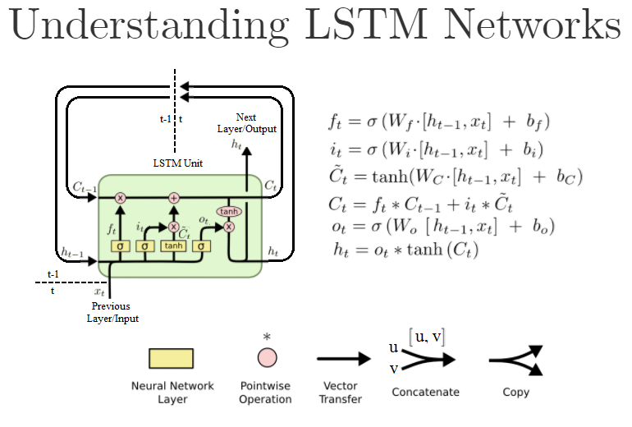
Word Classifier
Input: “reduces swelling and itchiness”
Classification
BiLSTM
3.2
-.2
0.3
1.3
…..
.
.
.
.
.
0.01
3.2
-.2
0.3
1.3
…..
.
.
.
.
.
0.01
3.2
-.2
0.3
1.3
…..
.
.
.
.
.
0.01
3.2
-.2
0.3
1.3
…..
.
.
.
.
.
0.01
[ , , , ]

Slide 25
N = 5 82.2% Test Accuracy
Prediction
 | Company address | Risk | Med. Ingred. | Dose | Claims | Comp. name | Non-med Ingred. | Product name | NPN
Company address | 307 | 2202 | 35 | 0 | 1330 | 1 | 5 | 631 | 76
Risk | 36 | 3754525 | 121 | 0 | 271108 | 39 | 6 | 1631 | 113
Medicinal Ingredients | 296 | 22512 | 2322 | 0 | 13728 | 26 | 96 | 6 | 129
Dose | 6 | 129 | 5 | 0 | 84 | 0 | 0 | 6 | 129
Claims | 45 | 510970 | 59 | 0 | 1656561 | 13 | 2 | 2608 | 198
Company name | 48 | 3092 | 23 | 0 | 1916 | 394 | 6 | 635 | 35
Non-med Ingredients | 34 | 5866 | 241 | 0 | 3715 | 7 | 219 | 1852 | 105
Product name | 502 | 139672 | 816 | 0 | 89493 | 209 | 78 | 58994 | 806
NPN | 3565 | 53270 | 1305 | 1 | 31760 | 100 | 104 | 14708 | 9549
True Class

Slide 26
Timelines
Train word classifier (late February)
Base w/ NHP dataset
Base w/ NHP + annotated OCR images datasets
Base w/ NHP + annotated OCR images + synthetic instances datasets
Fine-tuning
Finalize OCR spell checking (mid February)
Optimize Graph IE approach (mid/late February)
Proposals (mid March)
NPN (mid February)
Medicinal Ingredients
Company Name
Product Name
Claims
Compliance Assessment (March 31st)
API calls and logic
Report
Web App

Slide 27
OCR + SymSpell Analysis
896 Products
% OCR perfect match = 79.1%
Of these, 88.8% of the words match to multiple classes
334 of the products have exact NPN extracted
Total num NPN extracted is 451 (duplicates)
37.3% of products have NPN extracted via OCR step
1 Edit Distance
2 Edit Distance
10.2% (12,085 words) have no matches after OCR/SymSpell
Including SymSpell , 82.6% of OCR words get matched to vocabulary
Average of 1.4 classes per word in these symspell matches
An additional 18 NPNs get matched exactly via SymSpell (39.3% of products)
7942 (6.7%) of words have multiple matches
Using multiple matches an additional 87 NPNs are detected, yielding a total of 421 (47.0%) products with extracted NPN
Though these 87 NPNs match to many potential NPNs (to be confirmed by user)
5.6% (6,606 words) have no matches after OCR/SymSpell
Including SymSpell , 84.0% of OCR words get matched to vocabulary
Average of 1.3 classes per word in these symspell matches
An additional 39 NPNs get matched exactly via SymSpell (41.6% of products)
11, 758(9.9%) of words have multiple matches
Using multiple matches an additional 125 NPNs are detected, yielding a total of 498 (55.6%) products with extracted NPN
Though these 125 NPNs match to many potential NPNs (to be confirmed by user)

